Slide 1
Earth Observation in Natural England
A brief history and review
David Askew – Science Unit Manager

Slide 2
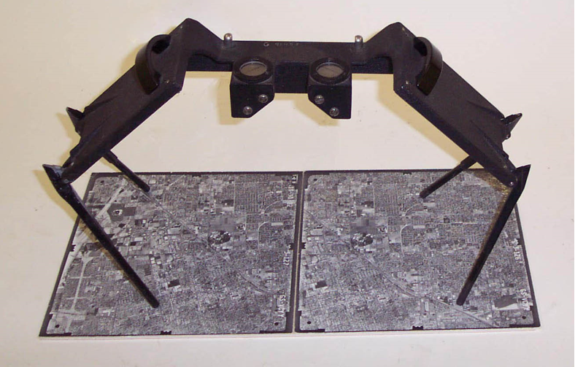
Remember this ?

Slide 3
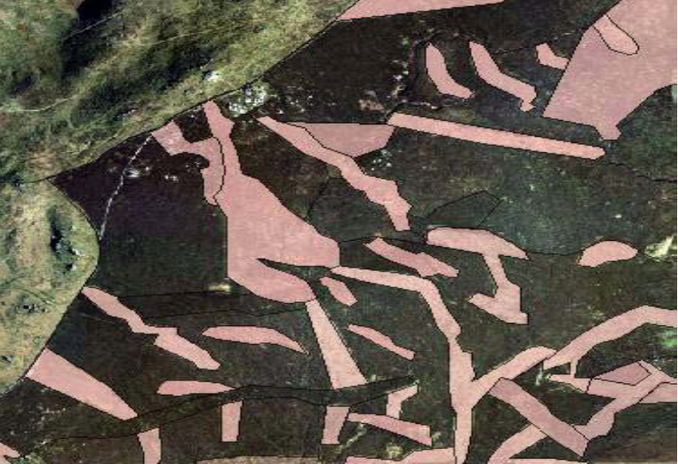
Rotational burning in the North Yorkshire Moors

Slide 4
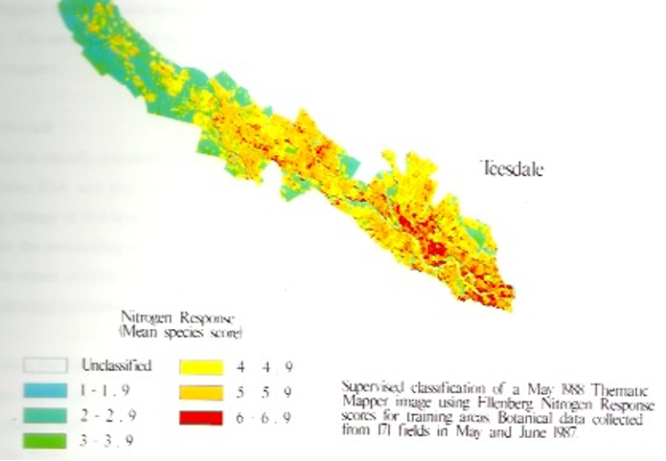
Trying to extract more – first forays into using satellite imagery
Nitrogen response scores for haymeadows - mapping conservation value in upper Teesdale

Slide 5
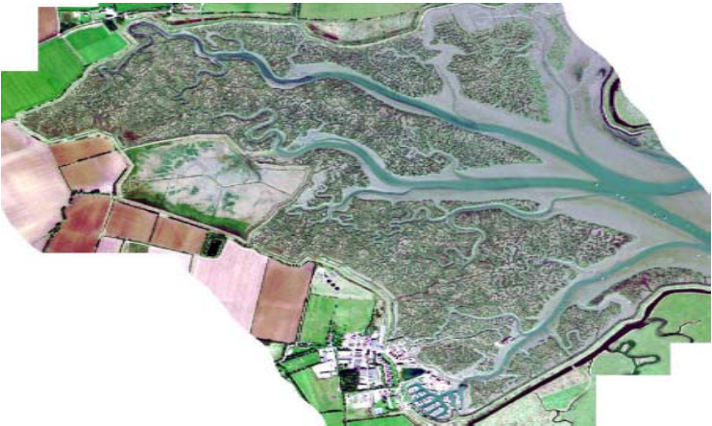
Coastal sites – dynamic environment and poor access
CASI image, Tollesbury Essex – collaboration with Geomatics,EA

Slide 6
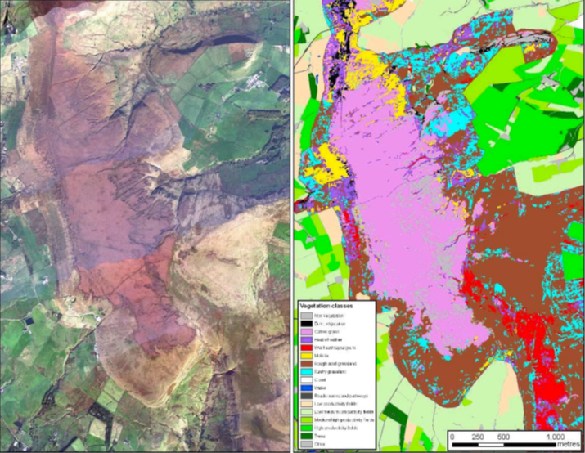
Where are we now ?
CASI image – habitats in the East Pennines – Cotton Grass dominated moor
Continuation of Geomatics collaboration

Slide 7
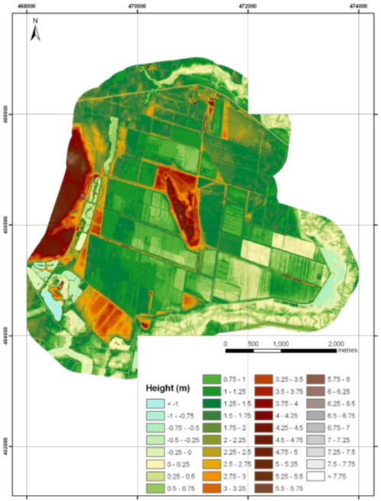
Detailed surveys for specific sites
Topographic data for Hatfield Moors NNR – Lidar data.
Restoring a peat extraction site.

Slide 8
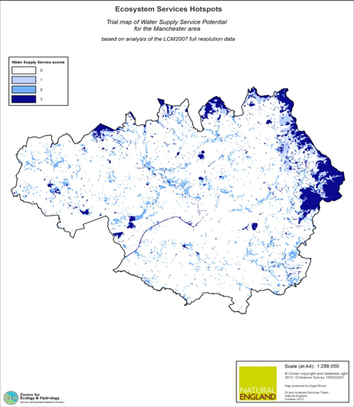
Using derived products - LCM2007
Mapping water supply services potential around Manchester

Slide 9
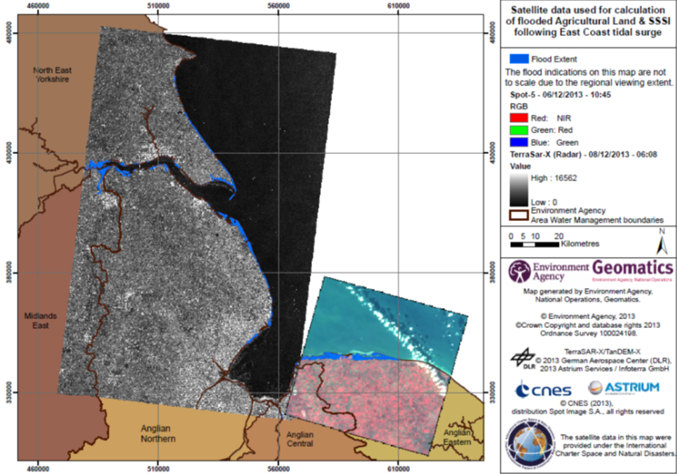
Emergencies

Slide 10
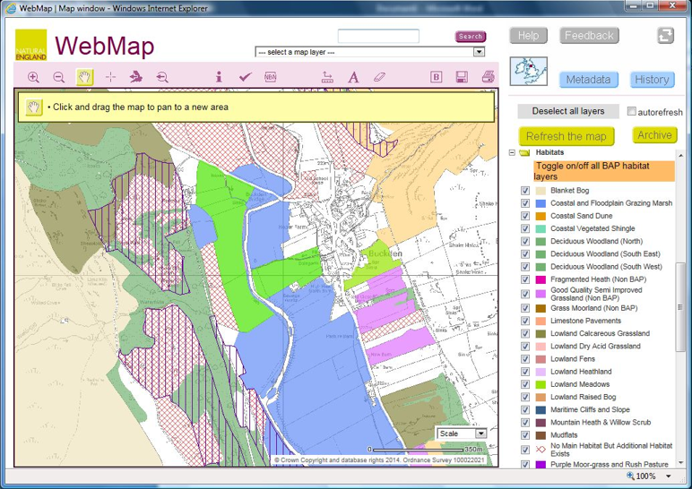
Whats next ?
Habitats – extent and condition

Slide 11
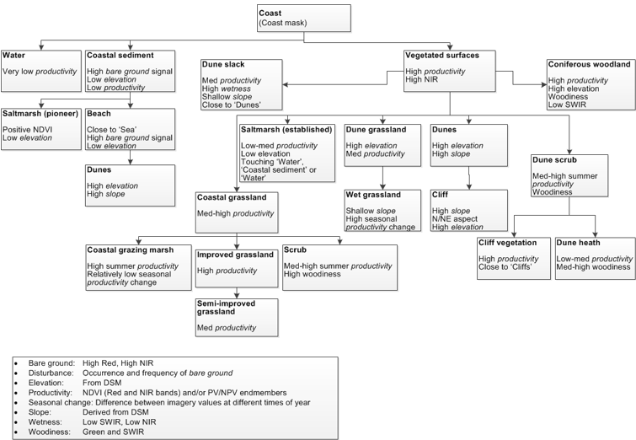
Environment Systems, 2011. Making Earth Observation Work for UK Biodiversity Conservation – Phase 1. Final report for Defra and JNCC.

Slide 12
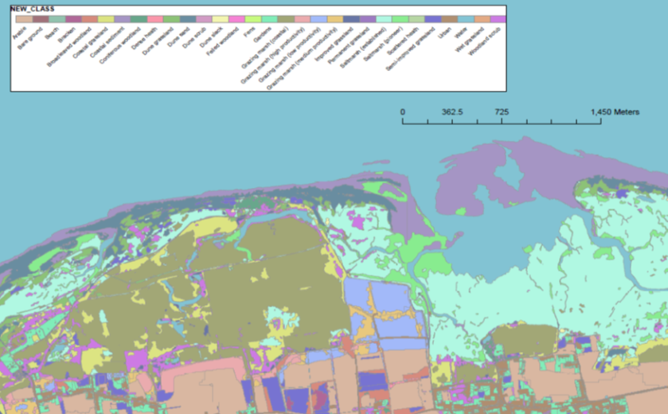

Slide 13
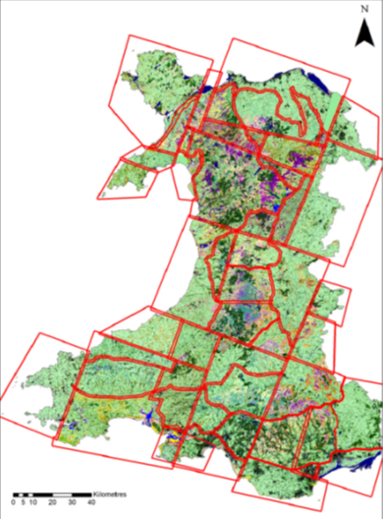
Its been done in Wales .....

Slide 14
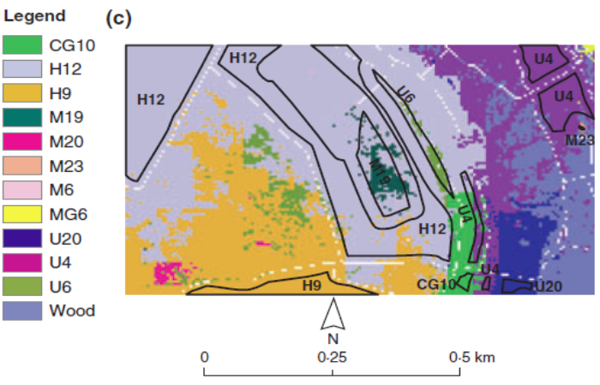
Can we map vegetation communities ?
Bradter, U., Thom, T.J., Altringham, J.D., Kunin, W.E., Benton, T.G., 2011. Prediction of National Vegetation Classification communities in the British uplands using environmental data at multiple spatial scales, aerial images and the classifier random forest. Journal of Applied Ecology 2011, 48, 1057-1065.

Slide 15
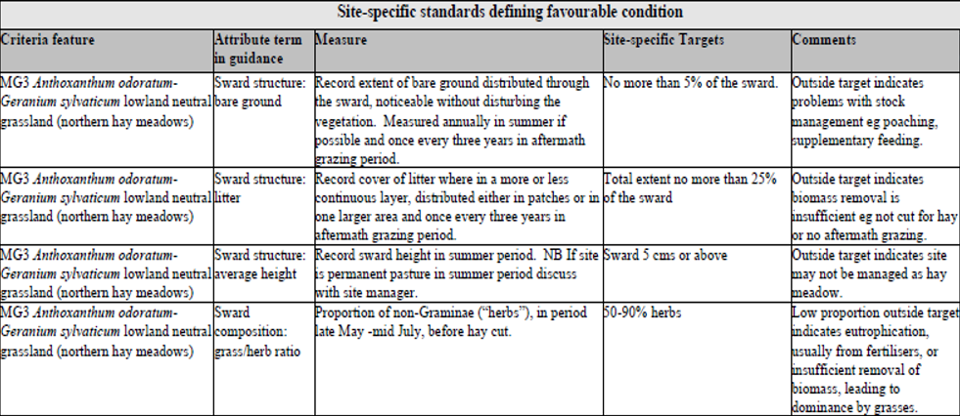
Condition of protected sites (SSSI’s) – key government target
Extract from Arkle Meadows SSSI ‘Favourable condition table’ ......
Grass/herb ratio or NDVI value ?

Slide 16
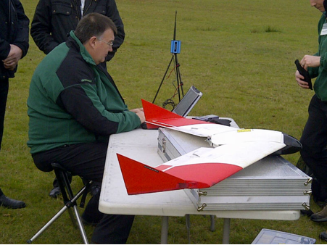
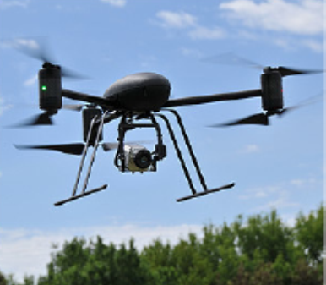
The current biggest area of interest ........

Slide 17
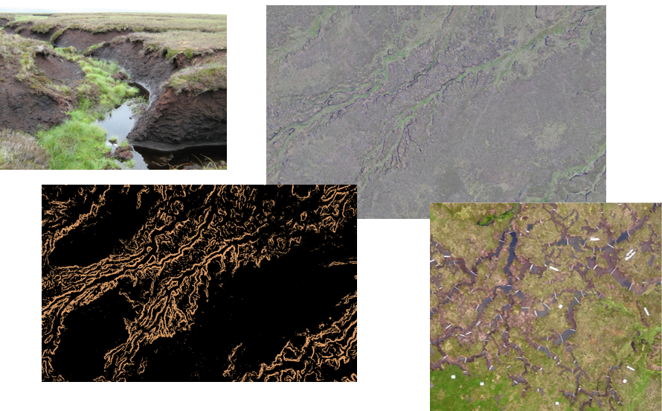
Yorkshire Peat partnership – mapping eroding peat bog to target restoration

Slide 18
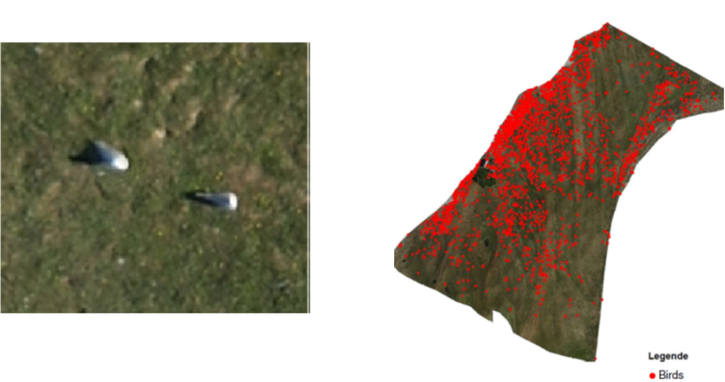
Wildlife surveys ......
Common Gull counts – University of Rostock

Slide 19
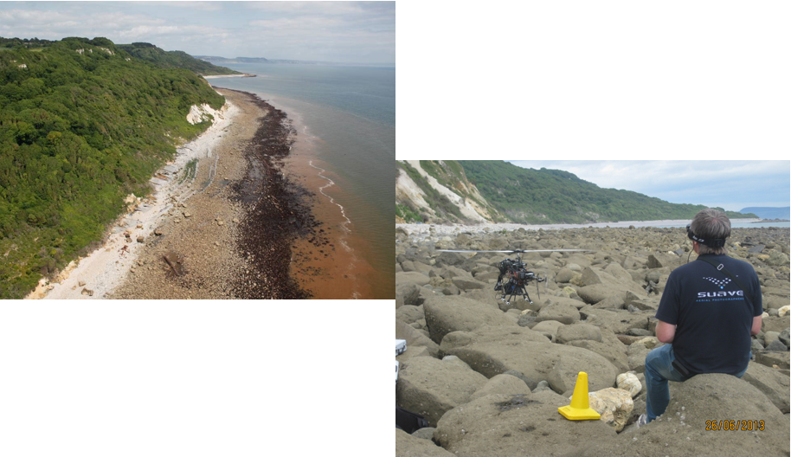
Mapping the plateau foreshore at Undercliffe NNR – with Plymouth coastal observatory

Slide 20
